Slide 1
Introduction to Embedded
System
Prajwal Acharya

Slide 2
Lecture Overview
What is an embedded system?
Embedded System vs PC
Characteristics of embedded systems
Real-time embedded systems
Hard and soft real-time systems
Embedded real-time systems
Embedded system components
Embedded system hardware
Embedded system software
Embedded system programming
Embedded software development
Requirements affecting design
Real-time requirements affecting design

Slide 3
What is an embedded system?
Embedded system
“A computer that doesn’t look like a computer”
“A special-purpose computer that performs a few dedicated
functions, usually with very specific requirements”
“Any device that includes a programmable computer but is not itself a general-purpose computer”
Includes both hardware and software
It is embedded as part of a complete device often including
hardware and mechanical parts
Often part of a larger system
A modern car can contain up to 100 embedded CPUs (airbag,
engine, brakes, stability control, dashboard, navigation, multimedia,…)
• Let’s start with some examples from the automotive industry…

Slide 4
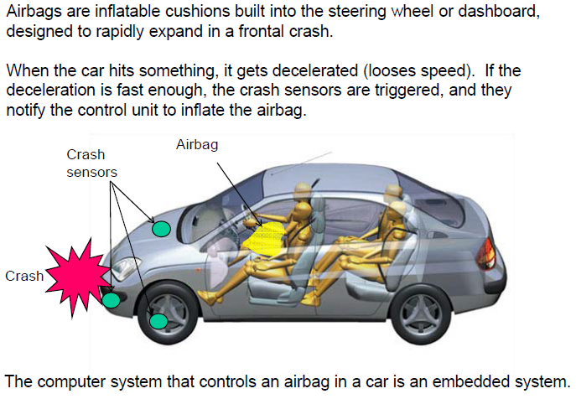
Example: Airbag

Slide 5
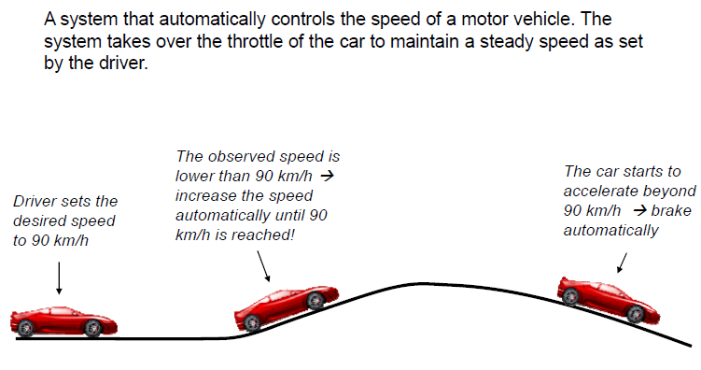
Example : Cruise Control

Slide 6
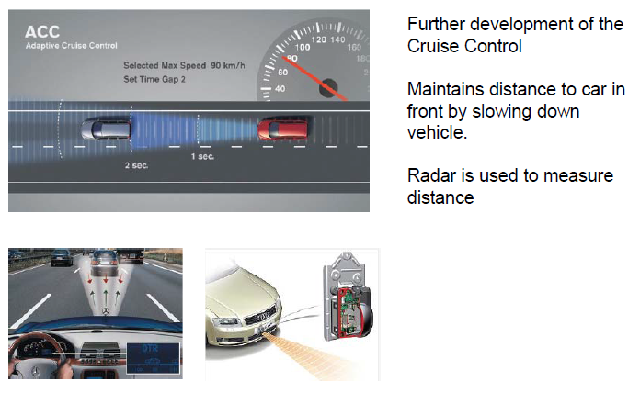
Example : Adaptive Cruise Control

Slide 7
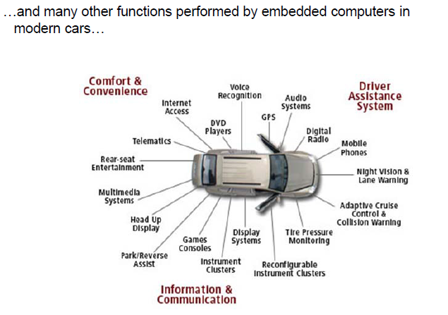
Example : Embedded systems in a car

Slide 8
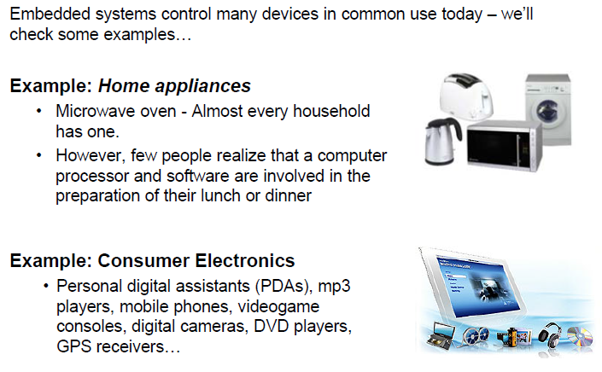
Other application areas...........

Slide 9
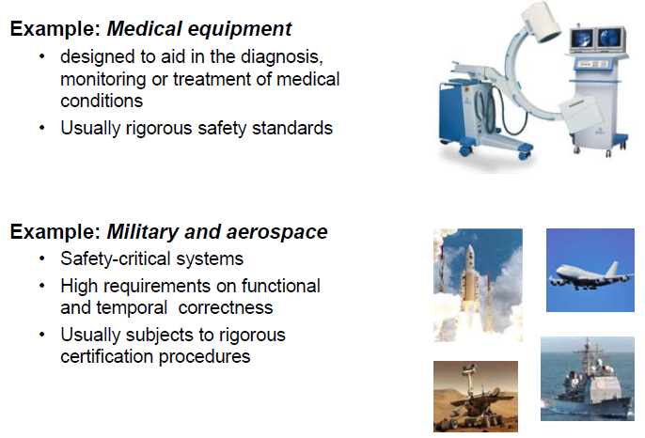
Other application areas...........

Slide 10
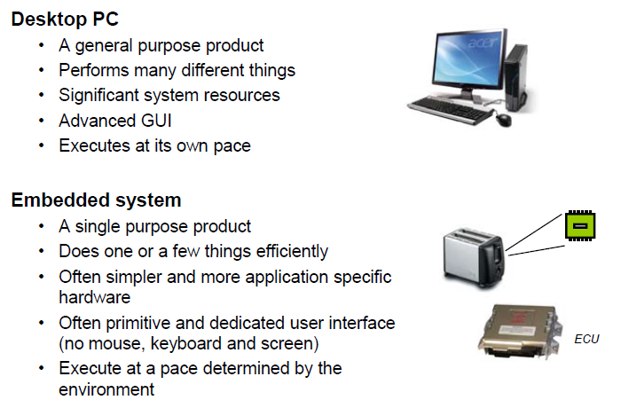
Embedded System Vs PC

Slide 11
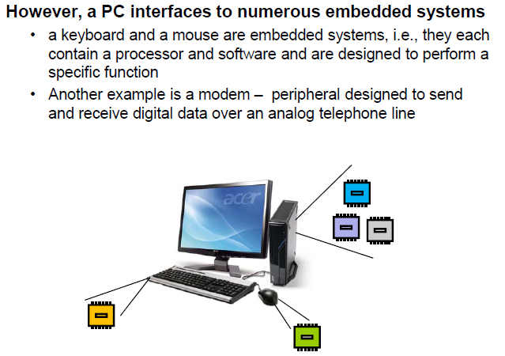
Embedded System Vs PC

Slide 12
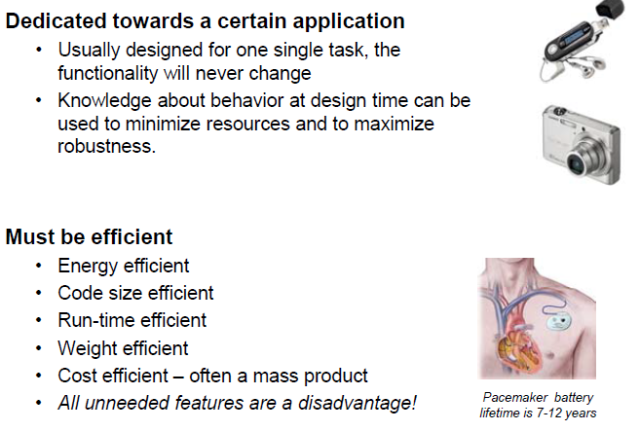
Characteristics of Embedded Systems

Slide 13
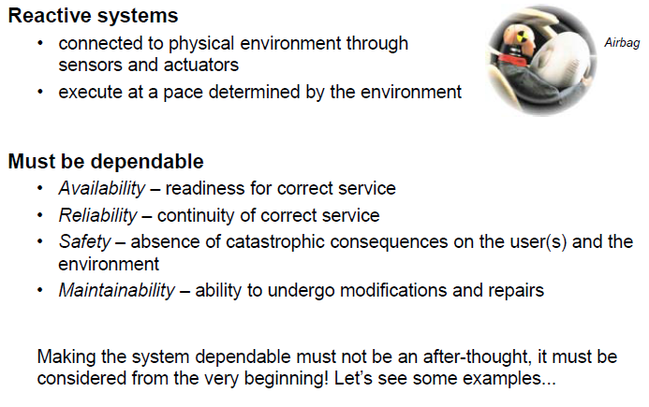
Characteristics of Embedded Systems

Slide 14
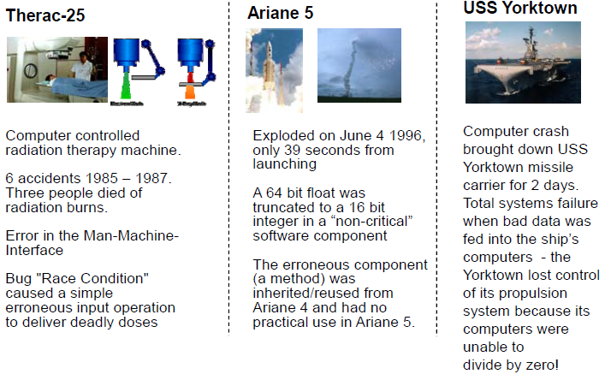
Failure of a safety critical Embedded System can cause catastrophic consequences

Slide 15
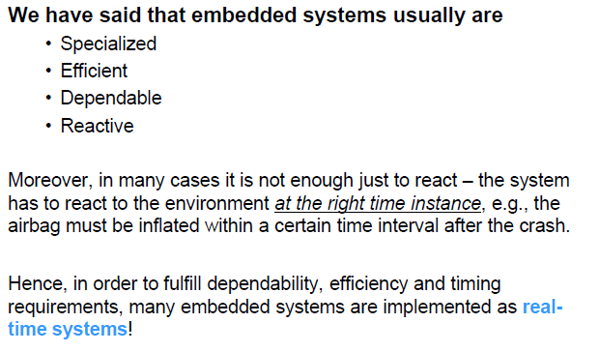
Real time Embedded Systems

Slide 16
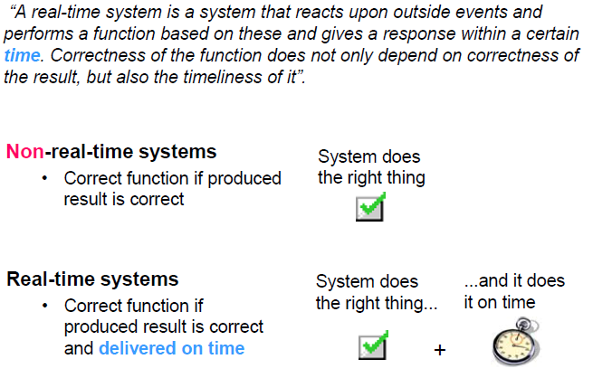
Real time Systems

Slide 17
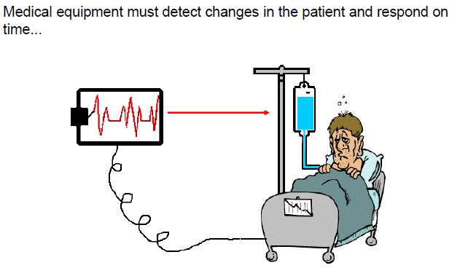
Example : Medical Device

Slide 18
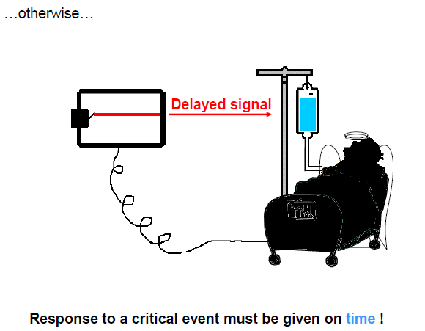
Example : Medical Device

Slide 19
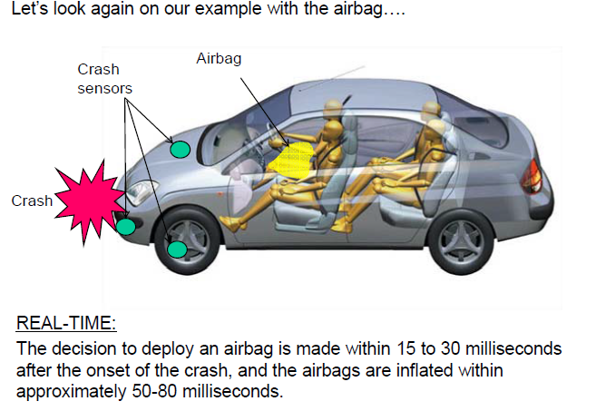
Example : Airbag

Slide 20
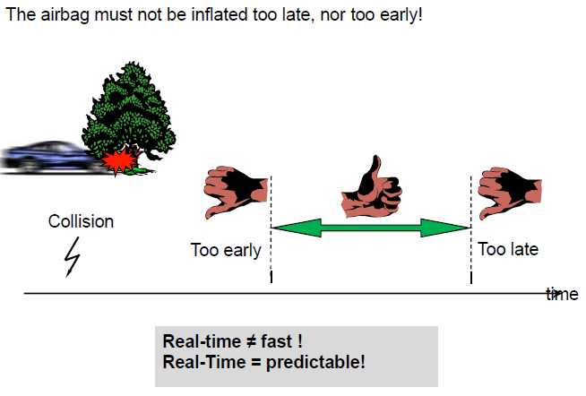
Example : Airbag

Slide 21
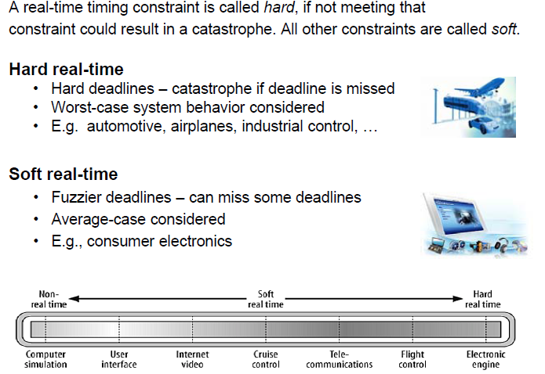
Hard and Soft Real time Systems

Slide 22
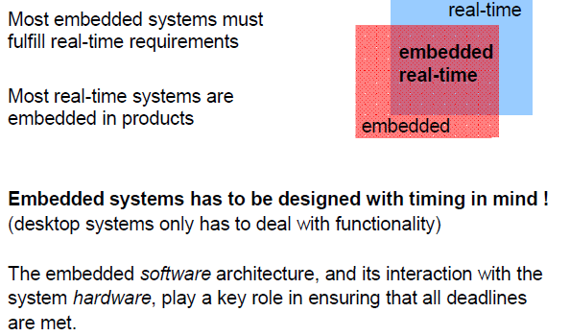
Embedded Real time Systems

Slide 23
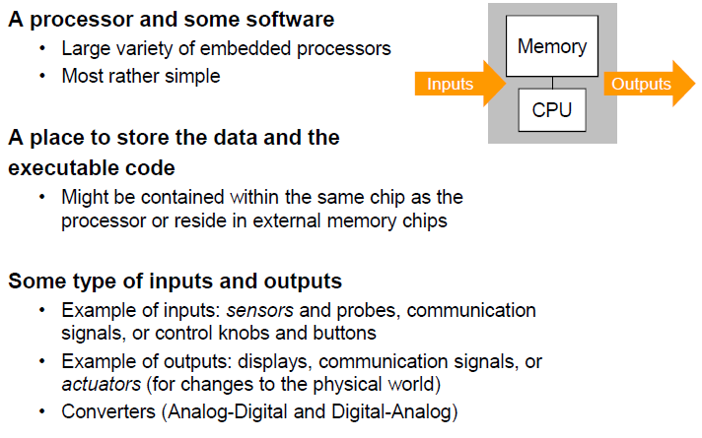
Embedded System Components

Slide 24
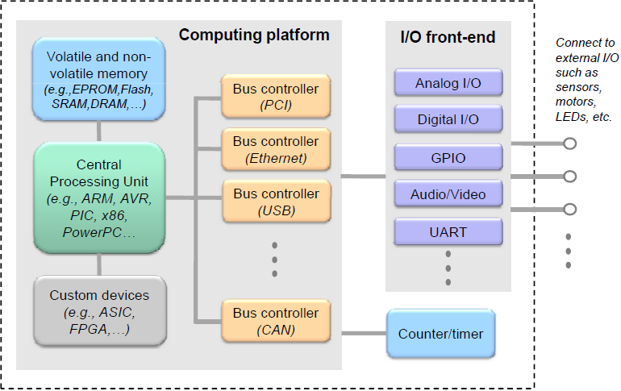
Embedded System Hardware

Slide 25
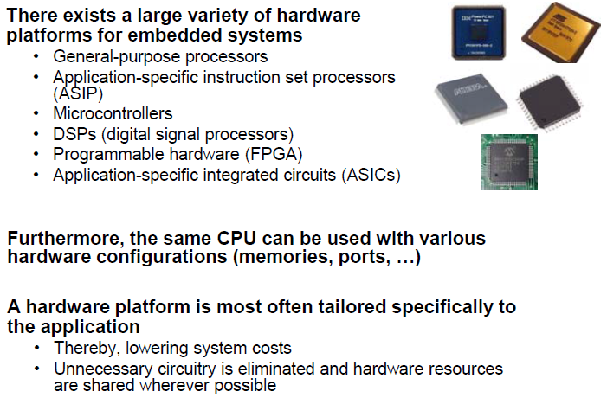
Embedded System Hardware

Slide 26
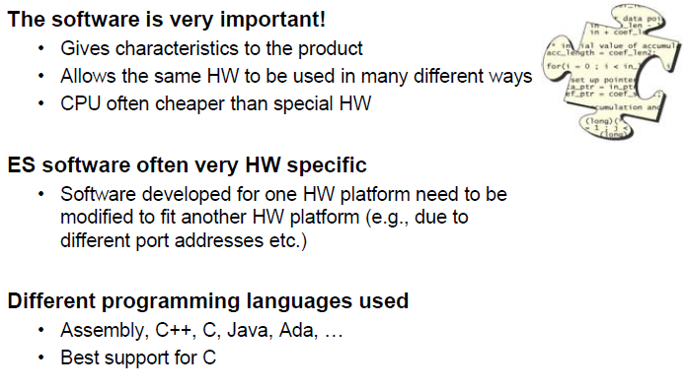
Embedded System Software

Slide 27
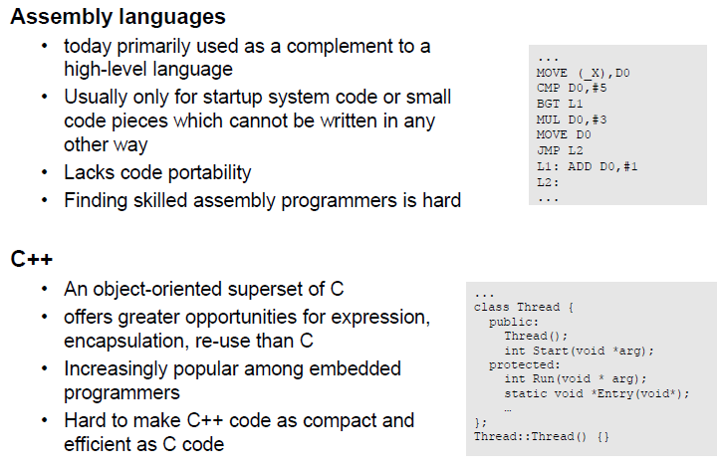
Embedded System Programming

Slide 28
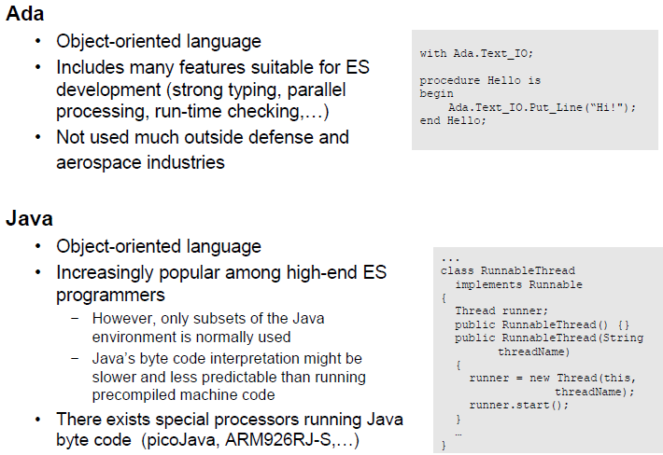
Embedded System Programming

Slide 29
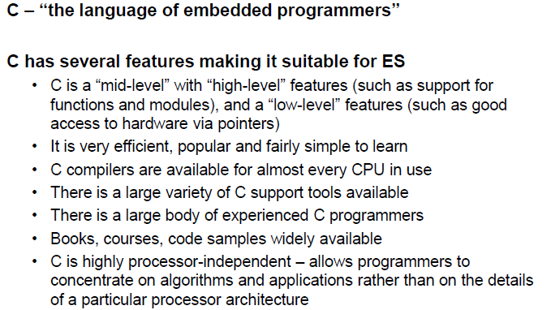
Embedded System Programming

Slide 30
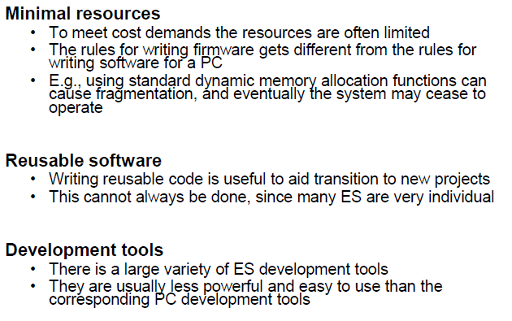
Embedded Software Development

Slide 31
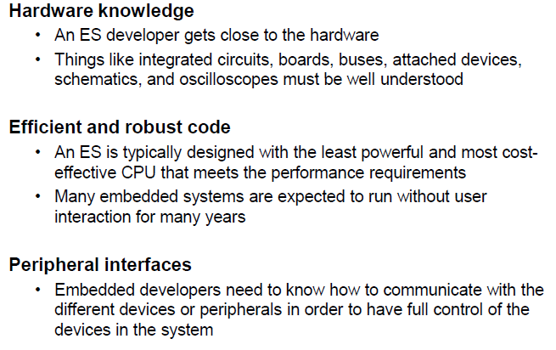
Embedded Software Development

Slide 32
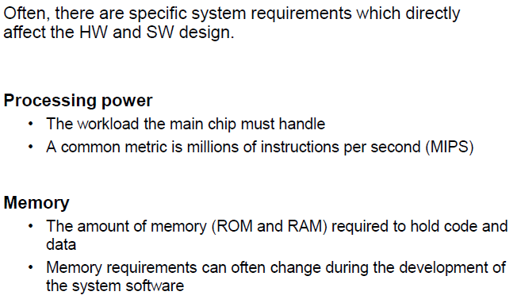
Requirement Affecting Design

Slide 33
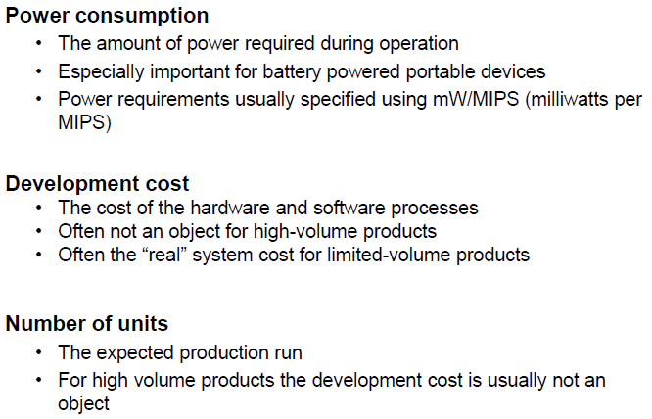
Requirement Affecting Design

Slide 34
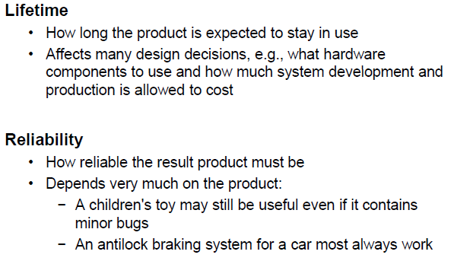
Requirement Affecting Design

Slide 35
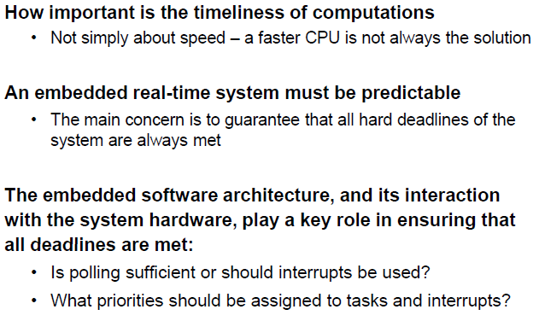
Real time Requirement Affecting Design

Slide 36
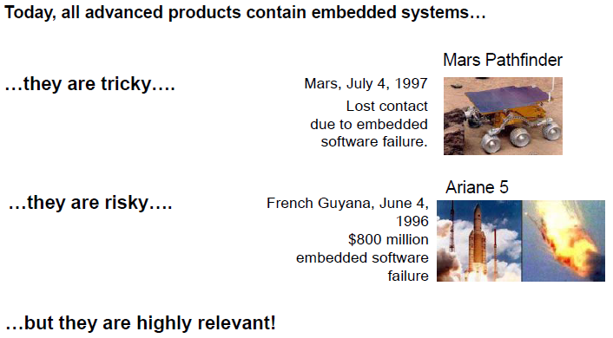
At Last ......

